Slide 1
WELCOME!
Kate Bell Family

Slide 2
Wraparound Services
Kate Bell Elem. WRS
Ms. Mason

Slide 3
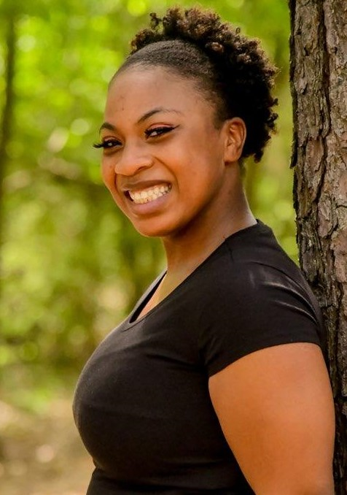
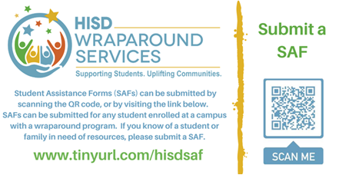
Allisia Mason
Email: Allisia.mason@houstonisd.org
Room: T6

Slide 4
Academics
Mental & Physical Health
Basic Needs
Enrichment programs
Community Engagement
Your Wraparound Specialist in the Connector!
YOU

Slide 5
How Can I help?
So… what do you do as the WRS here at ___________?

Slide 6
Types of Resources Resource Examples: -Clothes By Faith -Houston food Bank
Housing
Financial
Clothing
Food

Slide 7
Other Resources
After School/ Enrichment Programs
Mental Health
Dental/Vision Assistance
Parent Engagement

Slide 8
How to get help?
Complete a Student Assistance Form www.tinyurl.com/hisdsaf

Slide 9
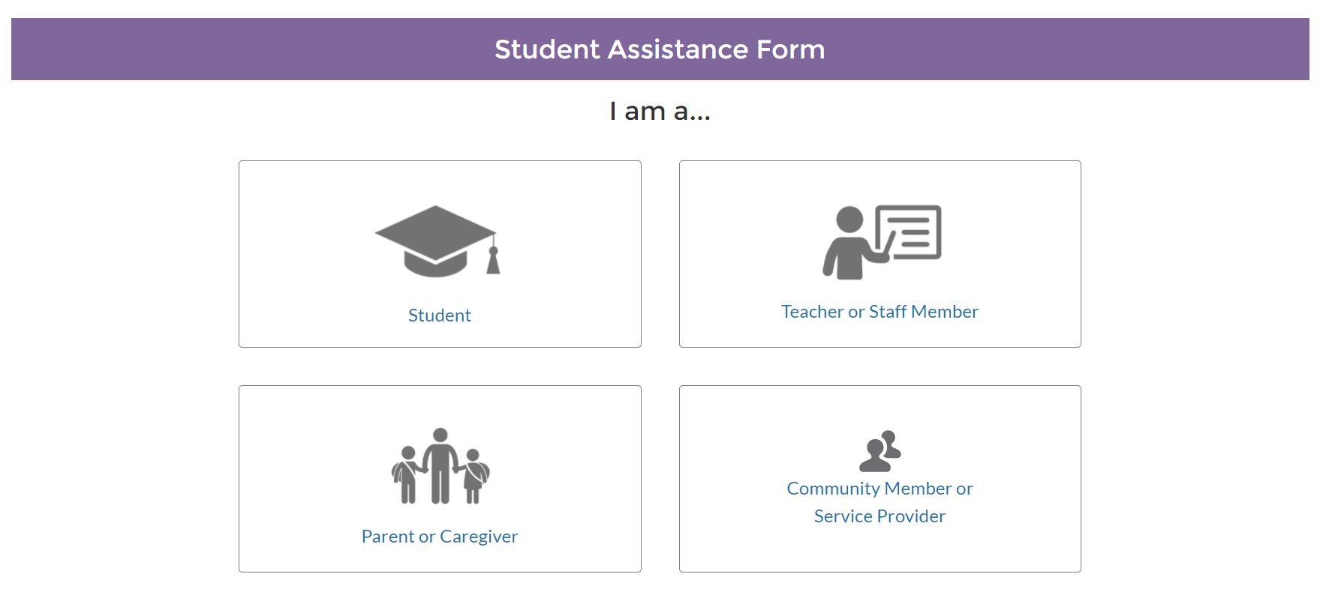
LET’S FILL OUT A SAF!

Slide 10
http://www.houstonisd.org/wraparound @HISD_Wraparound #WraparoundHISD Office: 713-556-5917
Wraparound Services Department
M

